Slide 1
Important Terms

Slide 2
pd.cut() → Converts continuous numerical values into categorical bins (groups) like low, medium, high.
pd.get_dummies() → Converts categorical text data into numerical columns (0 and 1) using one-hot encoding.

Slide 3
Skewed data → Data in which values are not evenly distributed and the graph is tilted more to one side (not symmetric).
Types:
Positive skew (Right skewed) → Long tail on right side (more small values, few very large values).
Negative skew (Left skewed) → Long tail on left side (more large values, few very small values).
Skewed data means the data is not balanced around the center.

Slide 4
Created two models & how to compare like linear & regression model
Compare Using Evaluation Metrics
For regression models, use:
R² Score → Higher is better
MAE (Mean Absolute Error) → Lower is better
MSE (Mean Squared Error) → Lower is better
RMSE → Lower is better

Slide 5
Example:-
from sklearn.metrics import mean_absolute_error, mean_squared_error, r2_score
import numpy as np
# Predictions
y_pred1 = model1.predict(X_test)
y_pred2 = model2.predict(X_test)
def evaluate(y_test, y_pred):
print("MAE:", mean_absolute_error(y_test, y_pred))
print("MSE:", mean_squared_error(y_test, y_pred))
print("RMSE:", np.sqrt(mean_squared_error(y_test, y_pred)))
print("R2:", r2_score(y_test, y_pred))
print("---------------------")
print("Model 1 Results")
evaluate(y_test, y_pred1)
print("Model 2 Results")
evaluate(y_test, y_pred2)
Model with higher R² and lower error values is better.

Slide 6
Compare Using Cross Validation (More Reliable)
from sklearn.model_selection import cross_val_score
score1 = cross_val_score(model1, X, y, cv=5, scoring='r2')
score2 = cross_val_score(model2, X, y, cv=5, scoring='r2')
print("Model1 Avg R2:", score1.mean()) print("Model2 Avg R2:", score2.mean())
Higher average score = better model.

Slide 7
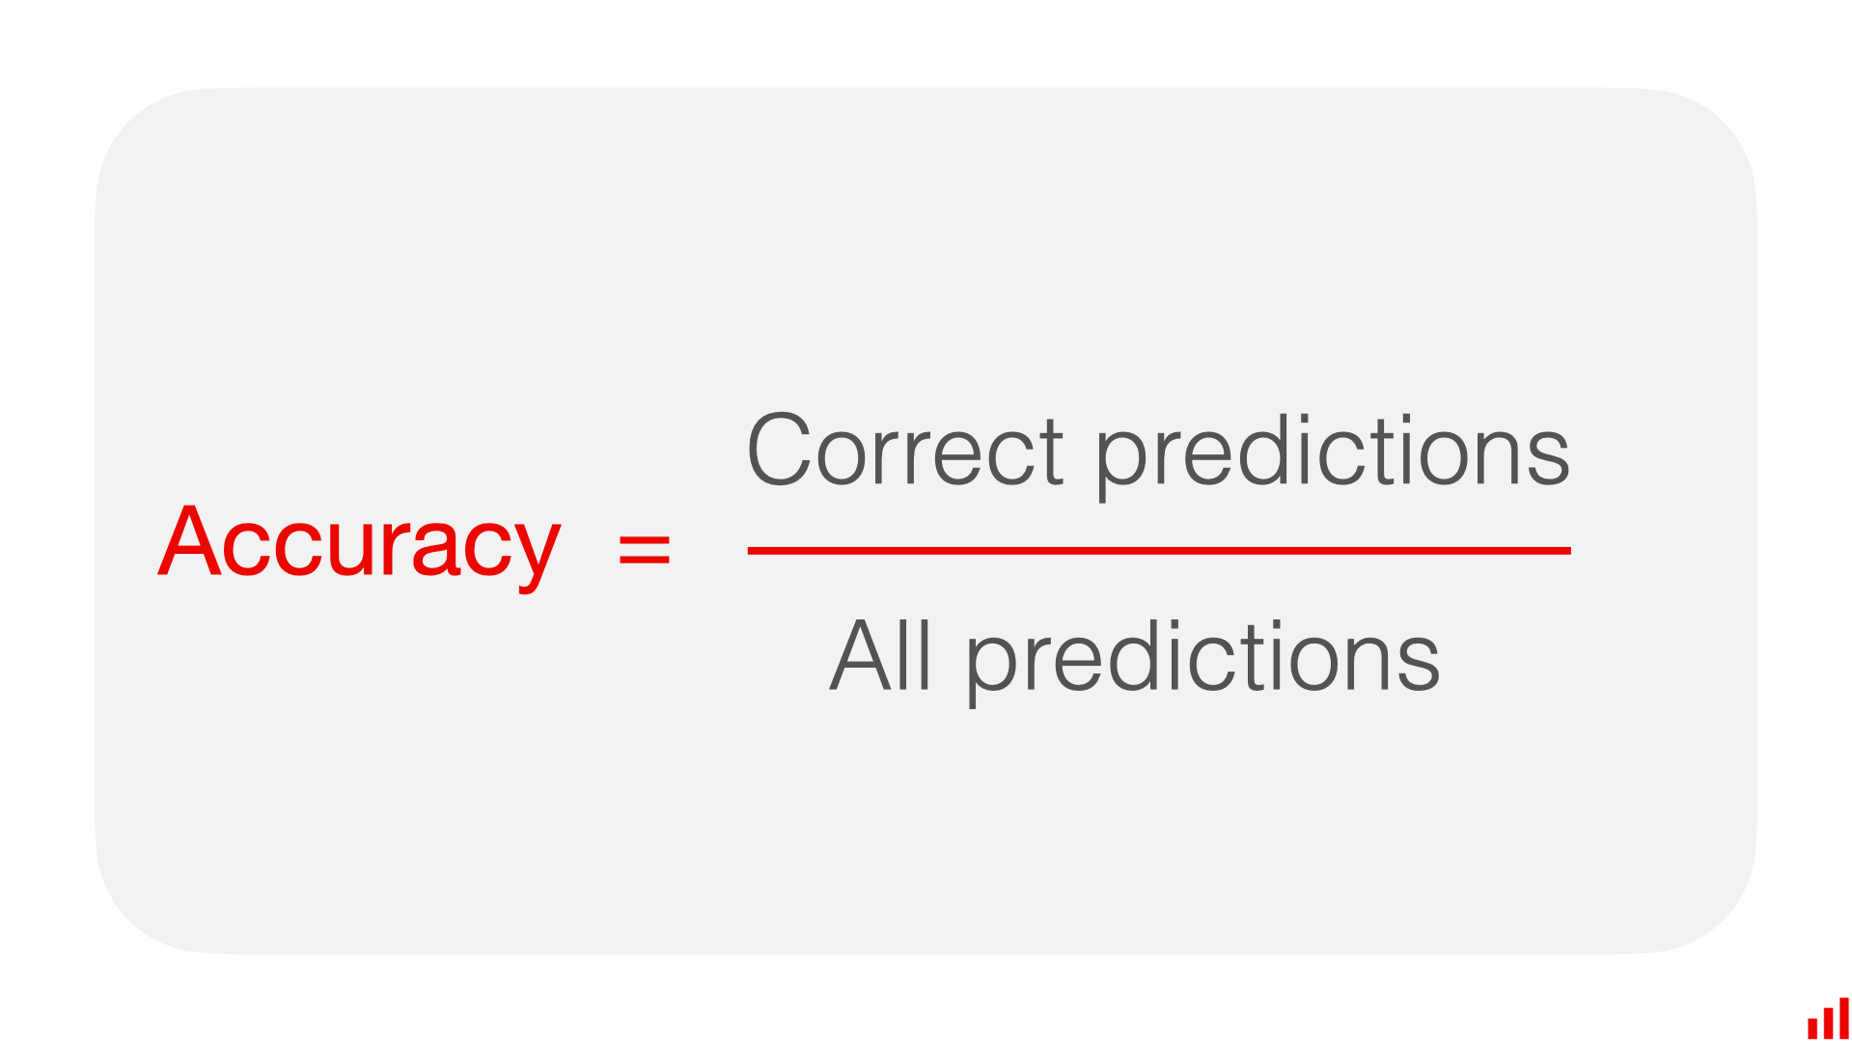
accuracy_score
accuracy_score() → It calculates how many predictions are correct out of total predictions (for classification models).

Slide 8
Evaluation Metrics for Linear Regression
Mean Squared Error (MSE) → Average of squared differences between actual and predicted values. Example: Actual = [2, 4], Predicted = [3, 5] → MSE = ((2−3)² + (4−5)²)/2 = 1
Mean Absolute Error (MAE) → Average of absolute differences between actual and predicted values. Example: Actual = [2, 4], Predicted = [3, 5] → MAE = (|2−3| + |4−5|)/2 = 1
Root Mean Squared Error (RMSE) → Square root of MSE; same unit as original data. Example: MSE = 1 → RMSE = √1 = 1
Coefficient of Determination (R² score) → How much variance in target is explained by model (closer to 1 = better). Example: R² = 0.9 → 90% of variation in actual values is explained by predictions
Residual Sum of Squares (RSS) → Sum of squared differences between actual and predicted values. Example: Actual = [2, 4], Predicted = [3, 5] → RSS = (2−3)² + (4−5)² = 2
Total Sum of Squares (TSS) → Sum of squared differences between actual values and mean of actual values. Example: Actual = [2, 4], Mean = 3 → TSS = (2−3)² + (4−3)² = 2

Slide 9
Gradient Descent for Linear Regression
It is one of the optimization algorithms that optimize the cost function (objective function) to reach the optimal minimal solution.
To find the optimum solution, we need to reduce the cost function (MSE) for all data points.
This is done by updating the values of the slope coefficient (B1) and the constant coefficient (B0) iteratively until we get an optimal solution for the linear function.

Slide 10
What is the Best Fit Line?
The Best Fit Line is a straight line that goes through data points in a graph in such a way that it shows the overall trend of the data.
It is the line that comes closest to all the data points.
It shows the general direction (upward or downward) of the data.

Slide 11
Example:
If you plot these points on a graph,
you will see they are increasing.
The best fit line is the straight line that shows:
More study hours → More marks
Hours Studied | Marks Scored
1 | 40
2 | 50
3 | 60
4 | 70

Slide 12
R-Squared (R²) is a metric used in Regression models to measure how well the model explains the data.
Simple Meaning:
R² tells us how much of the variation in the target variable is explained by the model.
R² Value Range:
R² = 1 → Perfect model (100% data explained)
R² = 0 → Model explains nothing
R² < 0 → Very bad model (worse than average prediction)

